Slide 1
Anomaly Detection in Online Reviews
Guided by: Prof. Leman Akoglu
Saransh Zargar
Santosh Kumar Ghosh

Slide 2
Motivation:
Online product reviews influence customer product purchase decision making heavily.
Opinion spammers try to manipulate product outlook by posting fake reviews.
So fake reviews must be detected and filtered out.

Slide 3
Problem Statement:
Given a dataset of reviews and associated reviewers find reviews that are suspicious and reviewers suspicious of spamming activities.
Baseline:
Review classification using Naïve Bayes method with feature selection.

Slide 4
The dataset :
The dataset on which the experiments were based was crawled from Yelp (www.yelp.com).
Data pertaining only to restaurants was used.
Number of restaurants analyzed: ~3000
Number of reviews analyzed: ~200,000
Number of reviewers analyzed: ~ 88,000

Slide 5
Feature Engineering - What features we used?
The entire feature set used can be logically partitioned into two groups:
Review Text Features
Reviewer/Meta Features
Review Sentiment
Rating
Entity Count
First Person V/s second person pronouns
Number of exclamation sentences
Length
Number of Capital Words
Similarity score using Bigrams
Keyword Relevance
Features
Reviewer friend count
Rating Deviation
Reviewer review count
Business popularity

Slide 6
How to detect spam from this huge dataset?
Intuition:
Model this as a classification problem. Reviews can be classified as belonging to “SPAM” or “NON-SPAM” class.
Supervised Learning comes to rescue:
Naive Bayes
Support Vector Machines

Slide 7
Naïve Bayes:
Simple probabilistic approach that treats each variable as independent by fitting a separate Gaussian curve for each.
Linear SVM:
Uses the concept of hyper plane to separate classes. Points are classified based on the hyper plane with the maximum margin.
Method | Precision | Recall | F-Score
Naïve Bayes | 0.426 | 0.821 | 0.561
Linear SVM | 0.335 | 0.689 | 0.451

Slide 8
Can we do better?
Turns out we can!
Use “feature selection” to remove redundant features from feature vector.
Chi-square method to select K-best features was used.
Number of Features(K) | F-Score (NB) | F-Score(Linear SVM)
K=4 | 0.585 | 0.467
K=5 | 0.557 | 0.439
K=6 | 0.534 | 0.451
K=7 | 0.542 | 0.407
K=8 | 0.538 | 0.452
K=9 | 0.546 | 0.457
K=10 | 0.551 | 0.433
K=11 | 0.558 | 0.448
K=12 | 0.561 | 0.451

Slide 9
Feature wise F-score distribution
Bi-Gram similarity, reviewer friend count, review count, length
Business Popularity
Entity Count
Sentiment Score
Personal Pronouns
K=4 | 0.585
K=5 | 0.557
K=6 | 0.534
K=7 | 0.542
K=8 | 0.538

Slide 10
Feature Selection Continued:
NB and SVM classifiers trained with “refined” feature set incrementally.
Top 4 features included: Reviewer Friend Count, Reviewer Review Count, Text Similarity with bigrams, Review Text Length

Slide 11
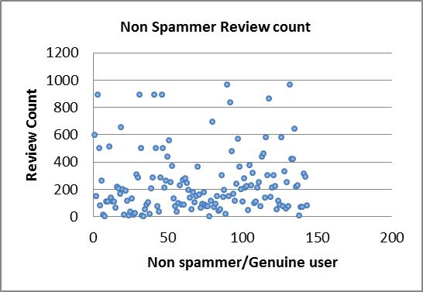
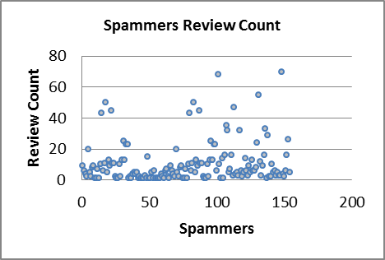
Observations corroborating feature selection:
Notice the Review Count (Y-axis)

Slide 12
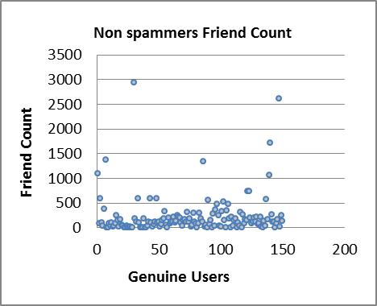
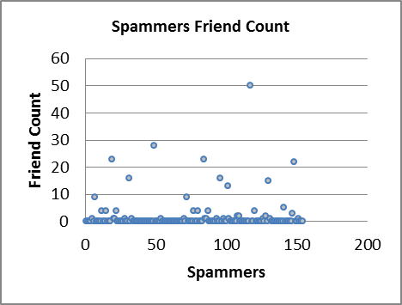
Observations corroborating feature selection:
Notice the Friend Count (Y-axis)

Slide 13
Issue with Supervised Learning
Large, diverse dataset needed for proper training of the classifiers
In real world getting labelled reviews is difficult
Manual labelling of reviews is tedious and unreliable
A different approach:
Semi supervised learning.
Key Idea: Incrementally annotate unlabeled data starting with a small set of labeled data.

Slide 14
Co Training : A semi supervised approach
Does not require large set of labelled data.
Start with a small labelled set.
Use it to annotate unlabeled data.
Add labelled data to training set to improve classifier incrementally.
Exploits the independent division of the feature set.

Slide 15
Control Flow of Co-Training:
Initial labelled Data
Training Phase
Classifier Algorithm (NB,SVM etc.)
Feature Set
Unlabeled Data
Add “p” positive and “n” negative labelled reviews to training set
Trained Classifier
Non Spam reviews
Annotated Data
Spam Reviews
Testing Phase

Slide 16
How much labeled data should I add?

Slide 17
Studying effect of classifiers on Co-Training
Efficiency of Co-training depends on the classifiers used
We tried Co-training with Linear SVM and Naïve Bayes
Training Method | Precision | Recall | F-Score
Co-Training(NB) | 0.453 | 0.802 | 0.579
Co-Training(linear SVM) | 0.413 | 0.692 | 0.518

Slide 18
Can we still do better?
Co Training still requires manual labelling.
Can we eliminate requirement of labelled dataset altogether?
Our solution:
Model spam detection as outlier detection problem
Local Outlier Factor
Motivation:
In real world datasets spam reviews form just a fraction of genuine reviews
So it is possible that they can be modelled as outliers

Slide 19
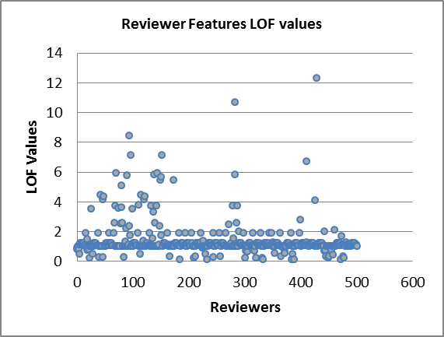
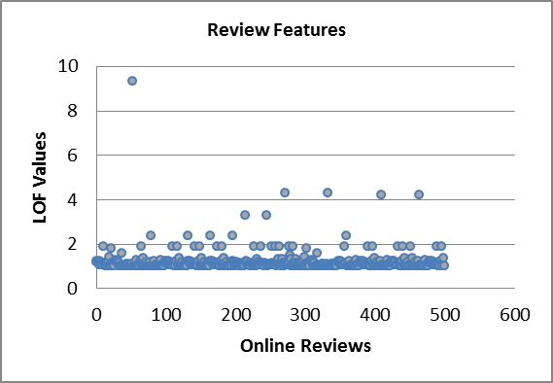
LOF Observations:

Slide 20
Interpreting LOF Results:
LOF not giving results better than supervised and unsupervised learning algorithms
Possible Reason:
Both genuine and spam reviews form some sort of cluster.
Reviews both genuine and fake which are outliers relative to these clusters are reported
 | Precision | Recall | F-Score
LOF | 0.447 | 0.608 | 0.515

Slide 21
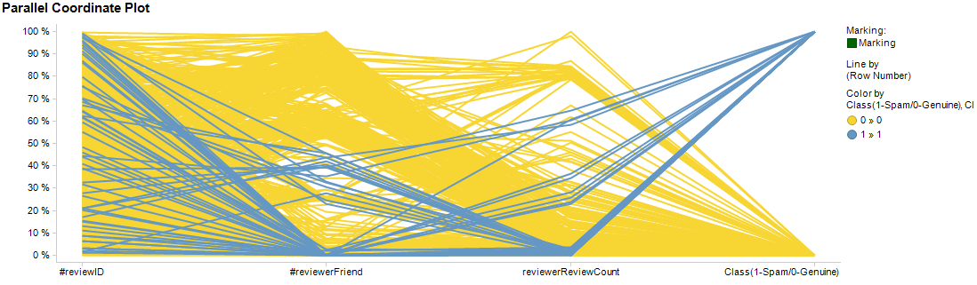
Local Clusters leading to false negatives and false positives

Slide 22
Which one to use?
Difficult to answer as the answer heavily depends on the specific data set used.
Some pointers
Method | Pros | Cons
Supervised Learning (Naïve Bayes, SVM) | Easy to use, good results with feature selection | Needs large,labelled dataset for proper classifier training.
Semi-supervised | Easy to use, requires small data set | Works best when there is logical split in the feature set.
Unsupervised | No labelled data needed | Curse of dimensionality

Slide 23
Comparative Study between different approaches
Method | Precision | Recall | F-Score
NB | 0.467 | 0.705 | 0.561
SVM | 0.335 | 0.689 | 0.451
Co-Training(NB) | 0.453 | 0.802 | 0.579
Co-Training(Linear SVM) | 0.413 | 0.692 | 0.518
Local Outlier Factor | 0.447 | 0.608 | 0.515

Slide 24
Acknowledgements:
Yelp.com
Scikit-Learn: (http://scikit-learn.org/stable/index.html) : For Python support packages.
Alchemy API (http://www.alchemyapi.com/) or providing support regarding keyword extraction and sentiment analysis.
Ravi for sharing the data crawled.
References:
Fangtao Li {fangtao06, yangyiycc}@gmail.com, Min lie Huang {aihuang, zxy-dcs}@tsinghua.edu.cn, Yi Yang and Xiaoyan Zhu
Kamal Nigam School of Computer Science Carnegie Mellon University Pittsburgh, PA 15213 knigam@cs.cmu.edu, Rayid Ghani School of Computer Science Carnegie Mellon University Pittsburgh, PA 15213 rayid@cs.cmu.edu. Understanding the Behavior of Co-training

Slide 25
Thank You

